Slide 1
DetailsView

Slide 2
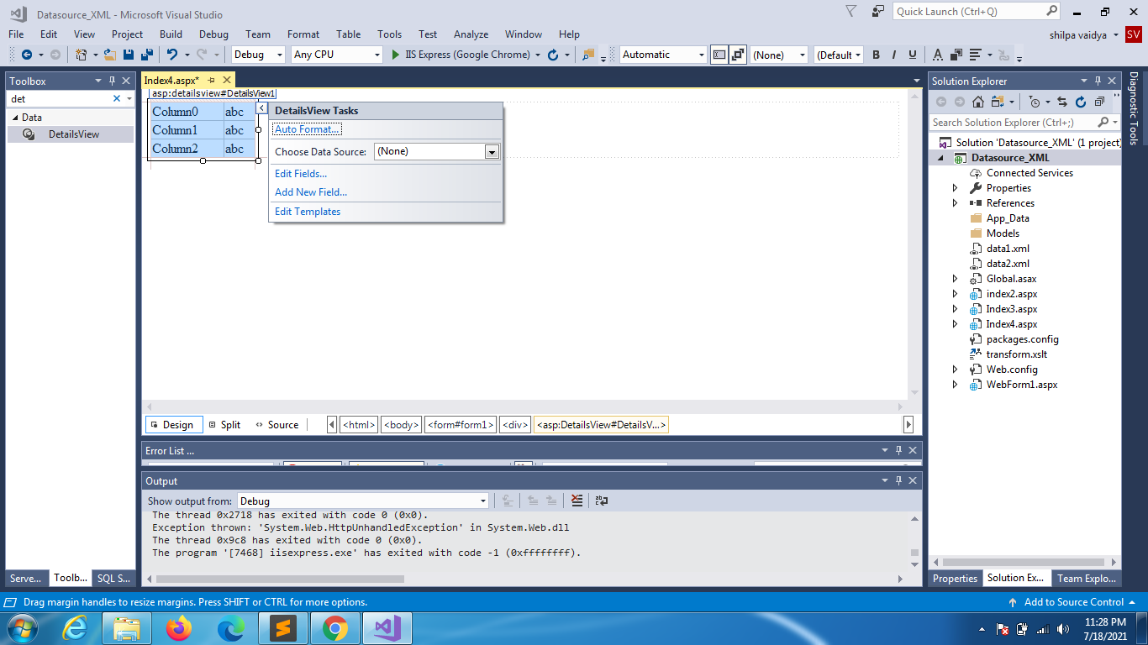

Slide 3
Create a Linq connection
using System; using System.Linq;
namespace SataSource_link
{
public partial class Index : System.Web.UI.Page
{
protected void Page_Load(object sender, EventArgs e)
{
DataClasses1DataContext context = new DataClasses1DataContext();
var data = from city in context.Cities
where city.Cid >= 1111
select new
{
city.Cid,
city.Cityname
};
/*
var data = from city in context.Cities
where city.Cid >= 1111
select city;
* */
DetailsView1.DataSource = data;
DetailsView1.DataBind();
}
}
}

Slide 4
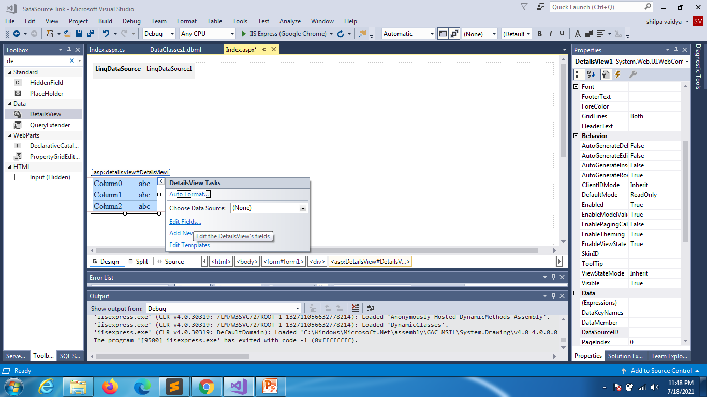

Slide 5
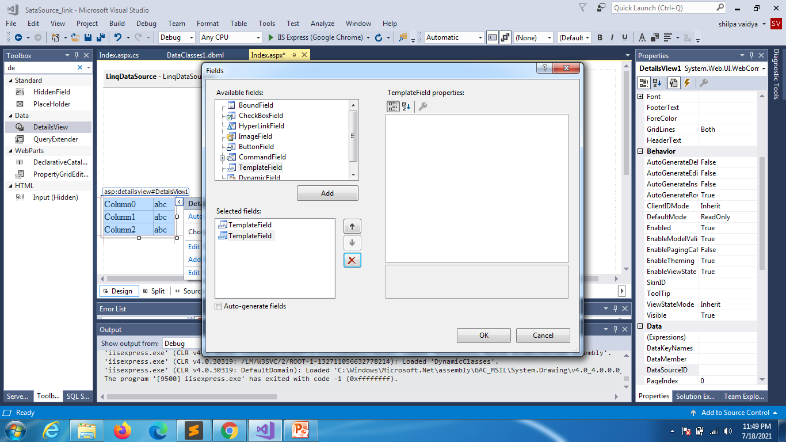

Slide 6
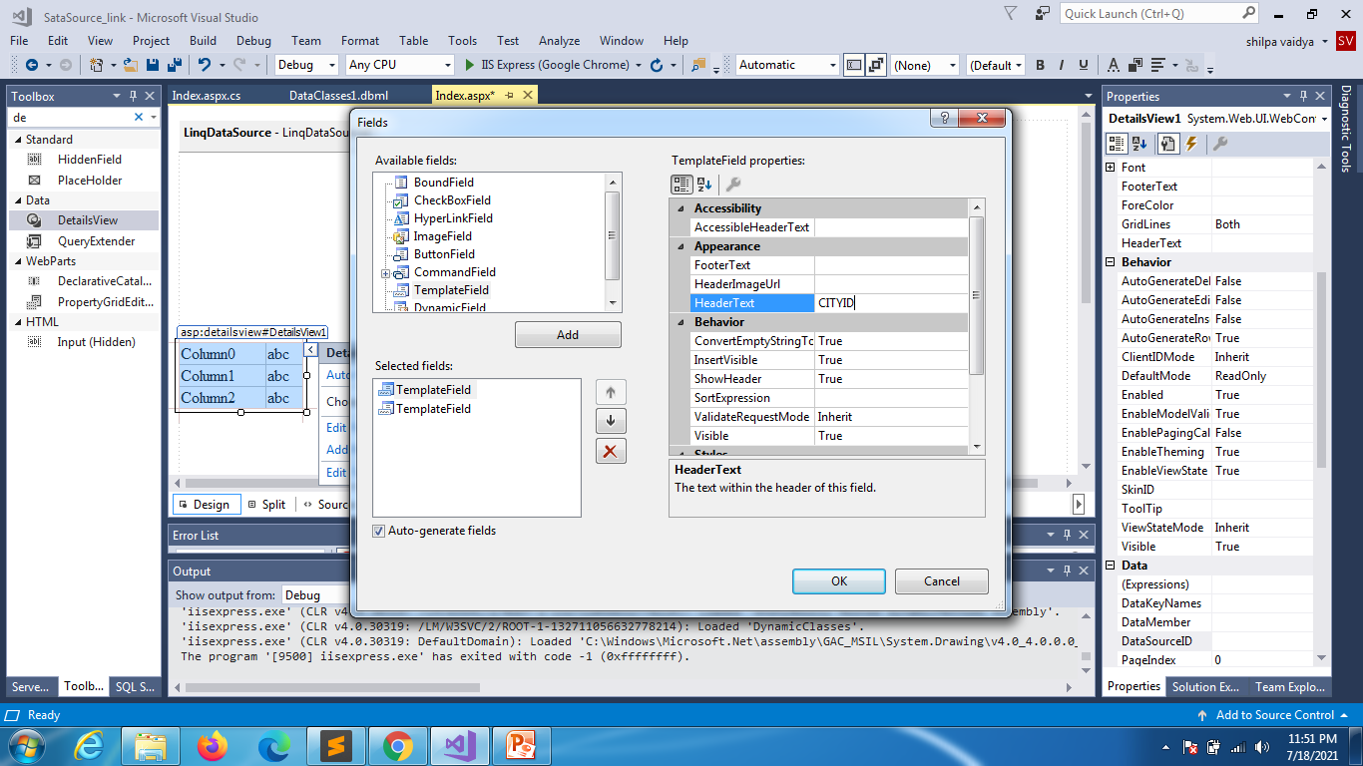

Slide 7


Slide 8
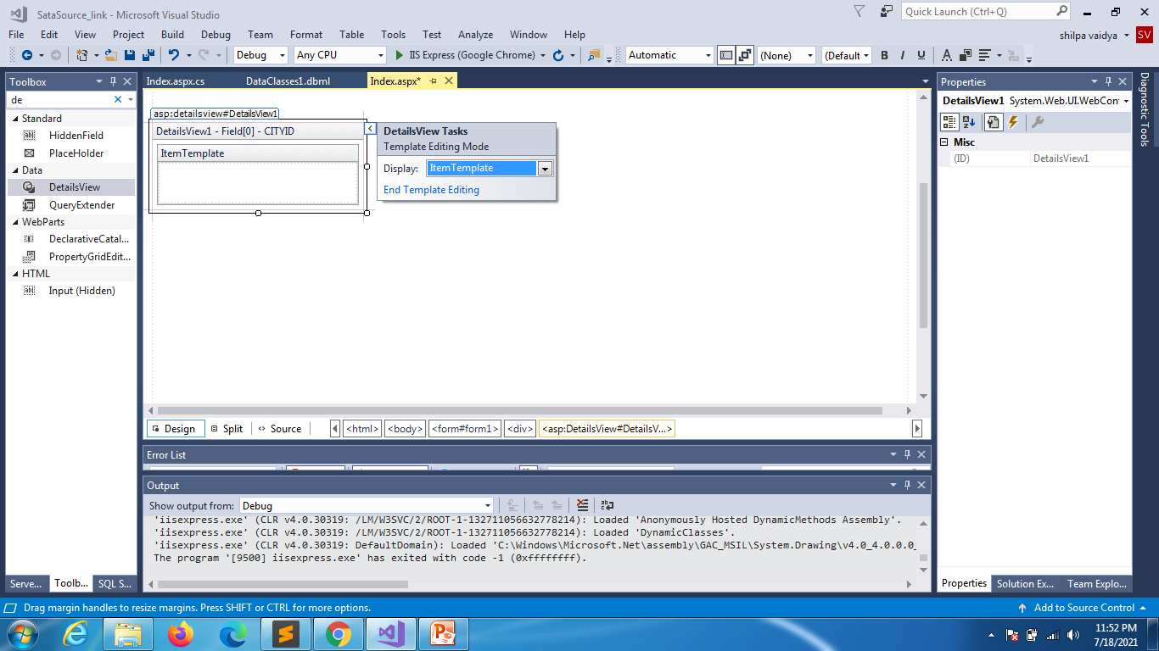

Slide 9
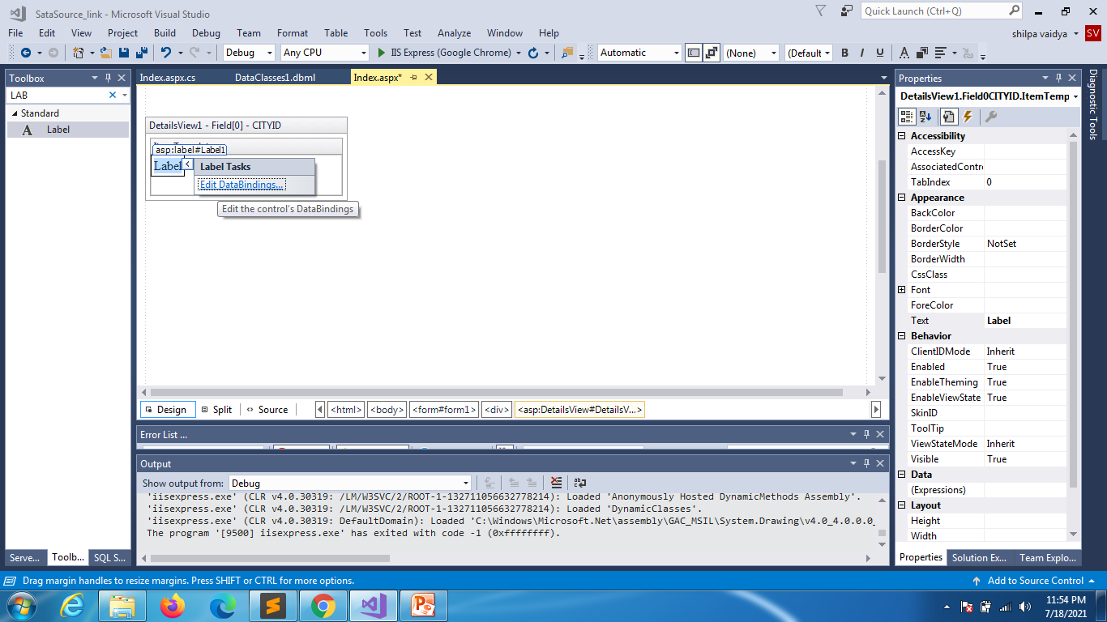

Slide 10
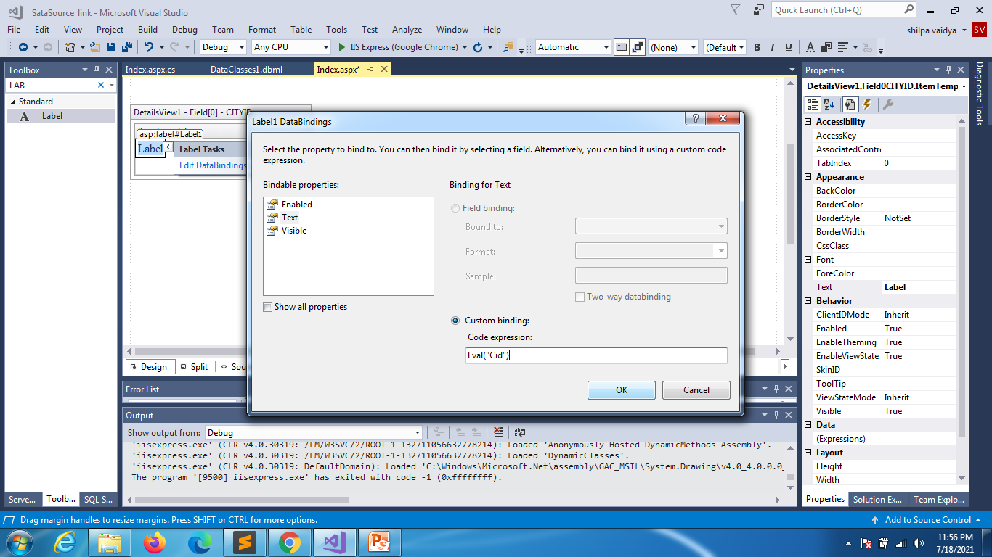

Slide 11
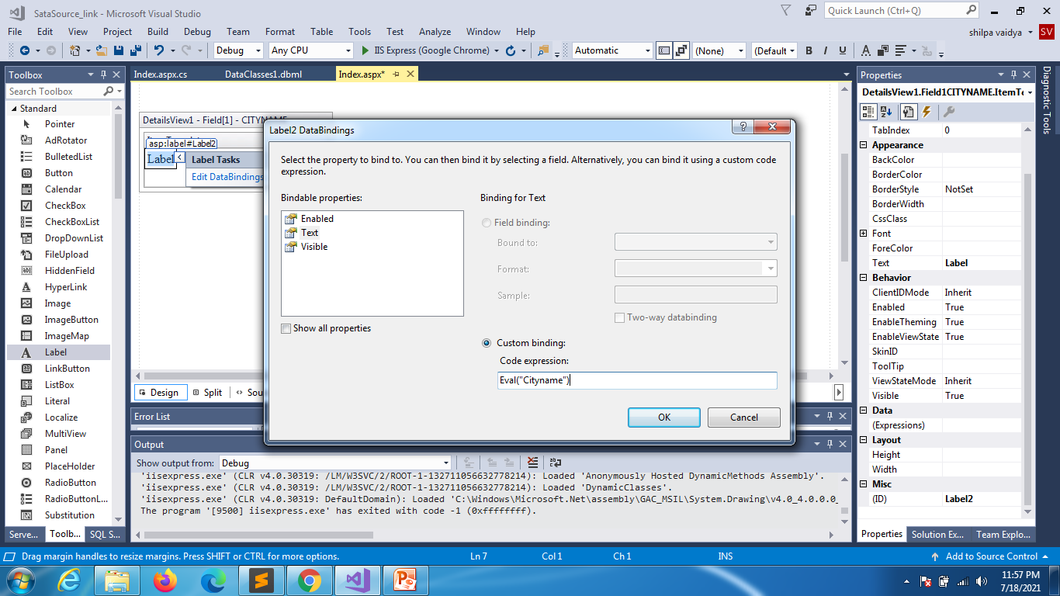

Slide 12
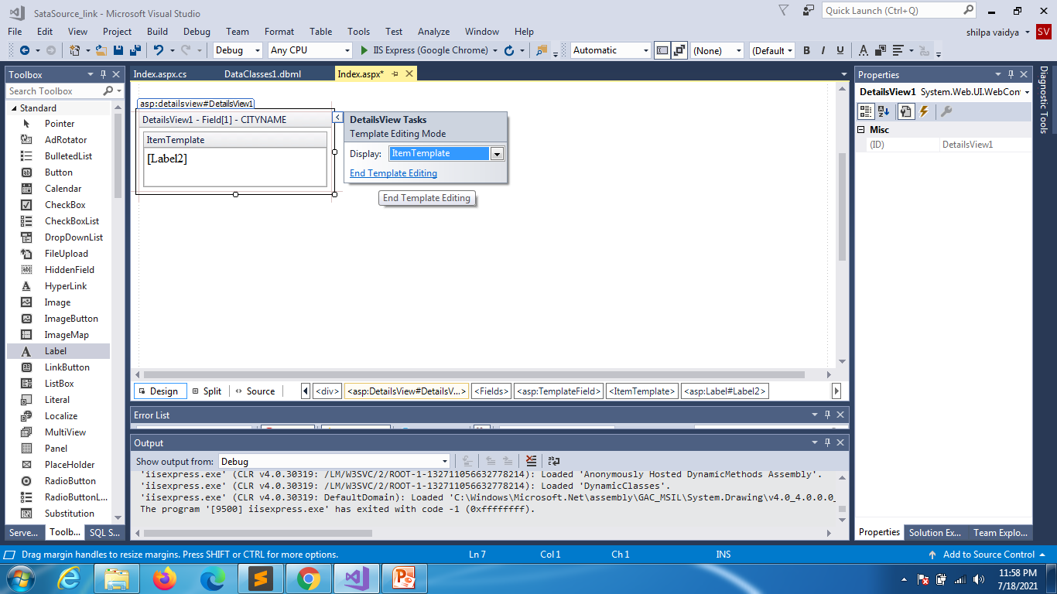

Slide 13
